Slide 1

Experiences Using Wood:
A Federal Agency Perspective
March 17, 2014
Presented By: Emilee P. Blount PE, Director
Engineering, Technology & Geospatial Services
USDA Forest Service
Notes:
Good morning; I’m excited to be here today to discuss success stories within the Forest Service and specifically with our experience using wood

Slide 2
The Case for Building with Wood
There are approximately 5 million commercial buildings in the United States of which 75% are between 1,000 and 10,000 square feet. It is estimated that 60% of the work planned for 2015 will be green.
McGraw Hill
Notes:
Read the Quote
USDA Secretary Tom Vilsack declared 2011 as the International Year of the Forest and directed the Forest Service to favor wood in new building construction, to maintain a commitment to certified green building standards, to examine ways to enhance research and development projects utilizing green building materials and to actively work to identify innovative, non-residential construction projects that use wood as a green building material.
Today, I’m excited to be able to share with you, the Forest Services accomplishments and our perspective on building with wood

Slide 3
Forest Service Engagement
Research and Development
  Expand the library of transparent information to include the US Life Cycle Inventory Database, increase awareness and acceptance of wood as a green building material through life cycle assessment data and tools.
  USDA Science Supporting the Economic and Environmental Benefits of Using Wood and Wood Products in Green Building Construction
  “A ton of bricks requires four times the amount of energy to produce as a ton of sawn softwood; concrete requires five times, steel 24 times, and aluminum 126 times.” Wood For Good, Popular Science
Notes:
Did you know, “A ton of bricks….
Our FS leaders in Research and Development as well as industry have found that harvesting, transporting, manufacturing, and using wood in lumber and panel products yields fewer air emissions – including green house gases
Through the work of a coalition of industry, conservation and our Forest Products Lab – Environmental Products Declarations (EPD) have been developed, these are similar to a Nutrition Label, outlining the environmental impacts of building products. We are working hard to , “expand the

Slide 4
Forest Service Engagement
State and Private Forestry
  Development of State wide Wood to Energy Teams
    5 states in 2013, Goal 8 states in 2014
  Utilization of wood to energy
    Nationwide map of mills and pellet plants, woody biomass volume and FS Facilities, conversion to wood heat
    Partnered with the Coast Guard, local school and FS visitor center to convert to wood pellet heat
    Local Grants
    Landfill avoidance
Notes:
Another Forest Service initiative being championed through our State and Private Forestry is the development of “Wood to Energy Teams” . These teams are looking at innovative ways to utilize wood with a current focus on biomass. We recently partnered with the Coast Guard, a local school and a FS visitor center to convert our heating system to wood pellets. We also completed a nationwide map linking the woody biomass volume within our Forests to local mills and pellet plants to look for further opportunities for conversion.
I returned last week from Madison Wisconsin where the FS sponsored another wood workshop; The Value of Wood and it’s many Applications, heard Mr. Gary Radloff of the Wisconsin Energy Institute brief on their states biomass assessment audit. This audit provided data by county on the density of their woody biomass and a mile radius identifier of processing sites. What I found really exciting was the State of Wisconsin’s desire to understand the linkage between their agriculture crops and the market opportunities across the state. They went so far as to develop a county land-use, decision tool to start the conversation around planting “energy crops” versus their current crop to more accurately quantify economic benefits.

Slide 5
Forest Service Engagement
Forest Service Climate Action Plan
  Wood construction – cut carbon pollution
  Resilient Forests: Manage Connected Risks
    Fire
    Drought
    Floods
    Insects
Notes:
I’d like to take a moment to highlite this book, Tackle Climate Change – Use Wood, this book was written on behalf of the North American forest products industry. Throughout this book there is discussion on the integral role of forest products, what does it mean to have sustainable forest management, what is the connection between wood, carbon and greenhouse gases.
Within the Forest Service’s Climate Action Plan we also show this linkage, and we talk about resilient forests, managing connected risks to reduce the impact severities of fire, drought, floods and insects, and we encourage other Federal Agency’s to do the same when developing their plans

Slide 6
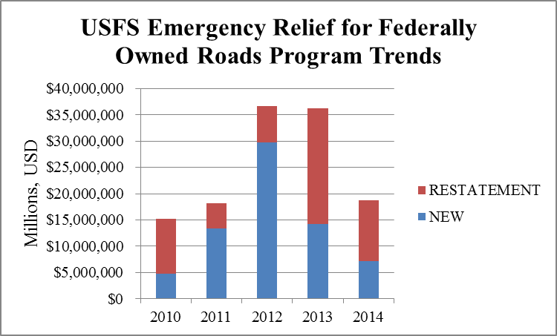
Forest Service Engagement
Climate Change
Notes:
Like many of you, the Forest Service’s infrastructure is aging, on average our facilities, roads, bridges and culverts are 50 years old. The necessity for emergency funds to our roads has more than doubled since 2010, from an average of $15M to a high of $36M. We are well on our way to exceed that number in 2014.
There is no doubt, the intensity and frequency of storm events are escalating and it’s obvious, our infrastructure is failing. Where feasible, the Forest Service is replacing culverts with resilient, aquatic organism passages and we’ve been providing training to states and counties on these new design techniques, most recently in the North East.

Slide 7
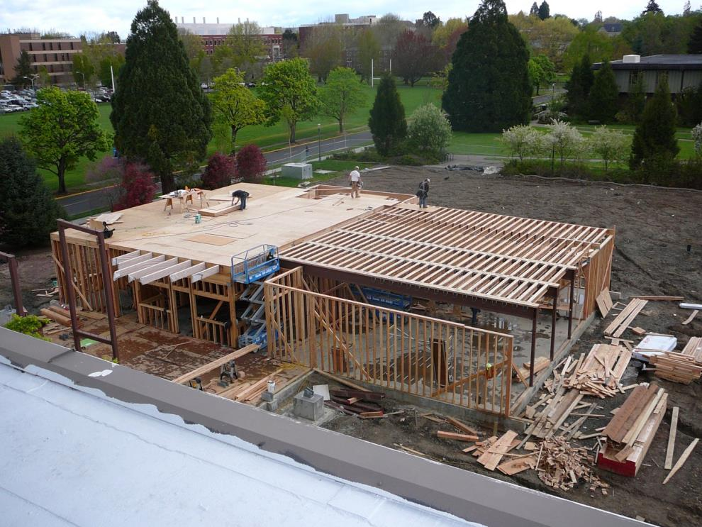
Co-location of Siuslaw National Forest Supervisor’s Office with the Corvallis Forestry Sciences Lab
Notes:
As the Director of Engineering, Technology and Geospatial Services within the National Forest System, I’d like to shift gears and highlite a few of our construction projects:
As you know, in March of 2013, All Executive Agencies were directed to implement Freeze the Footprint, in essence, there could be no net increase in square footage for offices and warehouses. Like you, the Forest Service is working hard to increase collaboration and co-location efforts not only within our agency but across Agriculture and through Service First agreements, with other Departments such as yourself.
The Co-location of the Siuslaw National Forest Supervisor’s Office and the Corvallis Forestry Sciences Lab located on the beautiful campus of Oregon State University, is a huge step in the right direction.

Slide 8
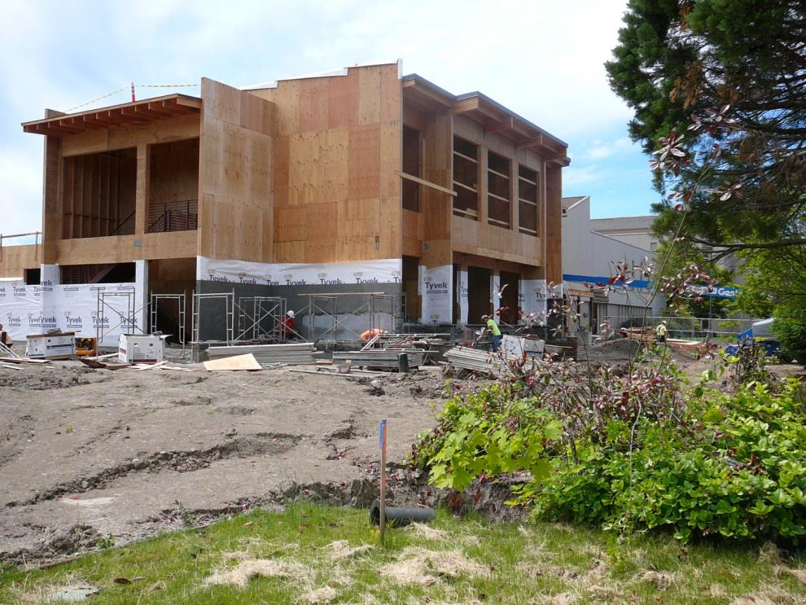
Co-location of Siuslaw National Forest Supervisor’s Office with the Corvallis Forestry Sciences Lab
Notes:
These two separate facilities totaled more than 105,000 SF, by consolidating like functions and focusing on maximizing our space utilization, we reduced our footprint to 97,500 SF and increased occupancy by 50 people

Slide 9
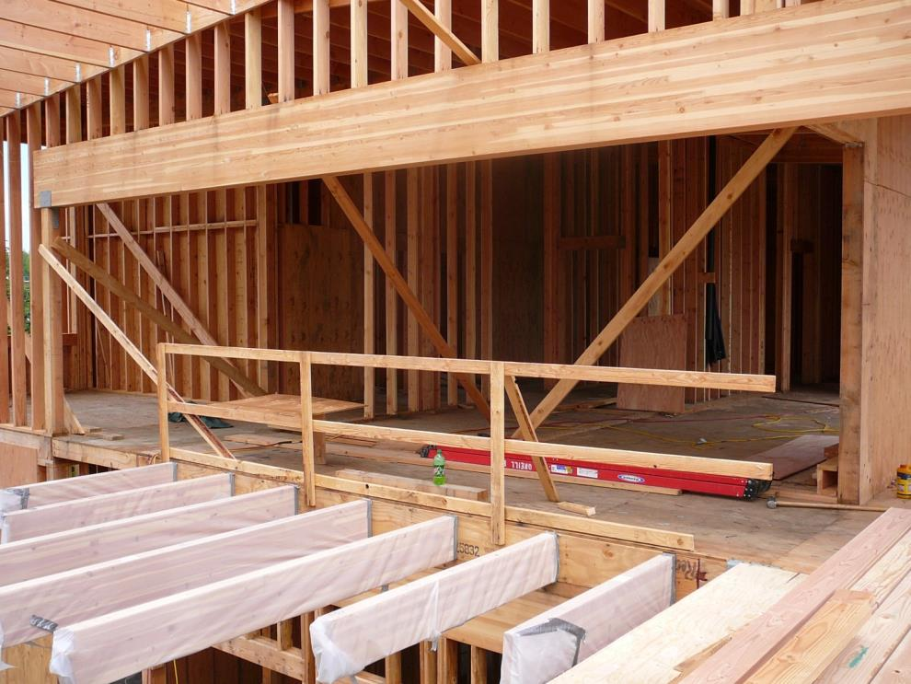
Co-location of Siuslaw National Forest Supervisor’s Office with the Corvallis Forestry Sciences Lab
Notes:
This facility was constructed exclusively with wood: within your handouts you will see the total volume of wood utilized: as an example
• over 10,000 BF of Douglas Fir

Slide 10
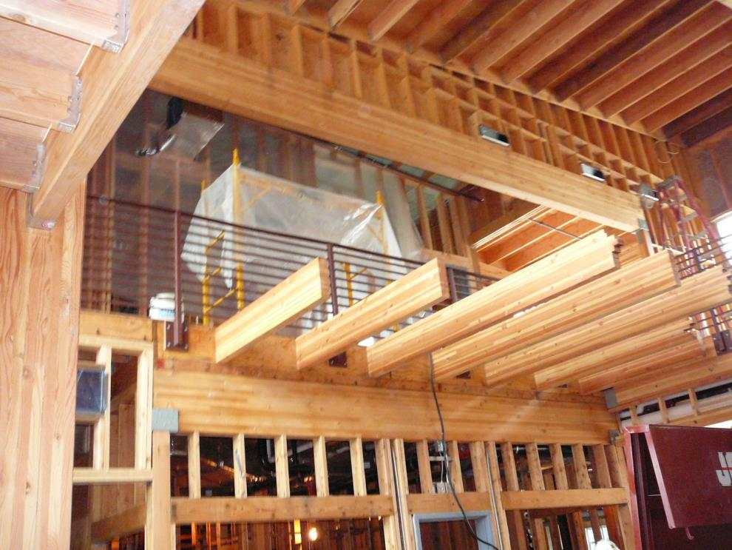
Co-location of Siuslaw National Forest Supervisor’s Office with the Corvallis Forestry Sciences Lab
Notes:
In addition to the use of wood, 95% of the waste by weight, was recycled or reused

Slide 11
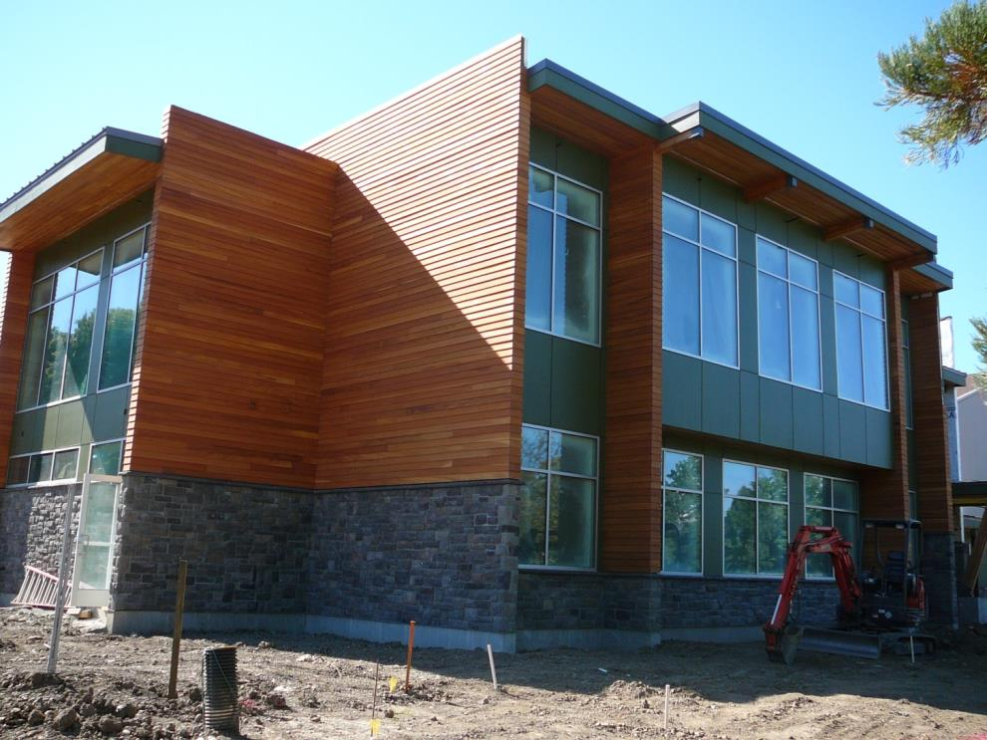
Co-location of Siuslaw National Forest Supervisor’s Office with the Corvallis Forestry Sciences Lab
Notes:
This facility has a state of the art HVAC system. Day lighting was improved with the use of 34 new windows and advanced lighting controls.

Slide 12
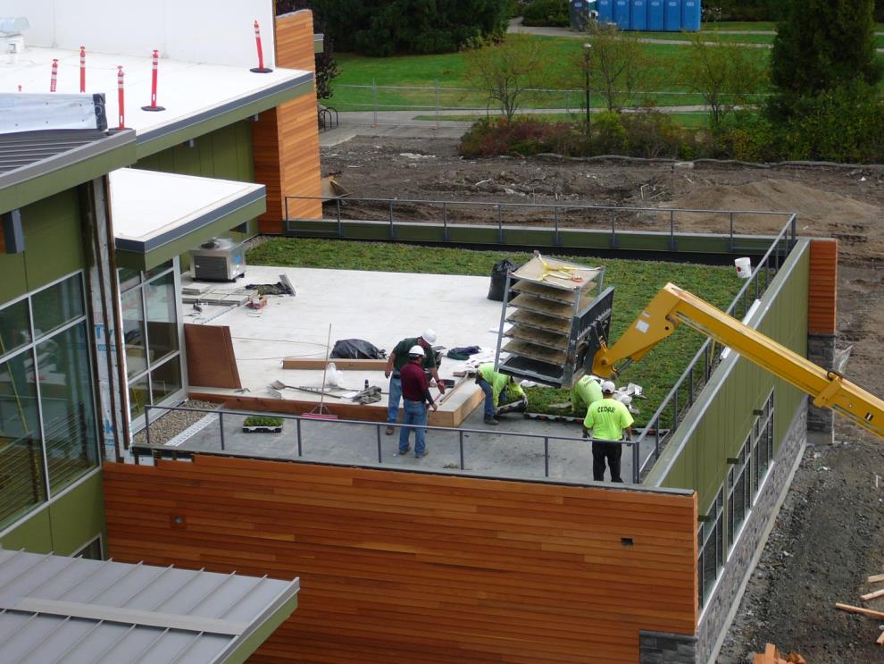
Co-location of Siuslaw National Forest Supervisor’s Office with the Corvallis Forestry Sciences Lab
Notes:
Other significant energy saving items include:
• Steam heat provided by the University’s new cogeneration plant
• A living roof garden
• a rain screen insulating wall system
• Lighting controls to harvest available daylight
• Advanced energy meters to monitor electrical and water usage

Slide 13
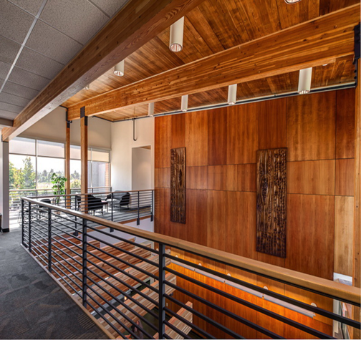
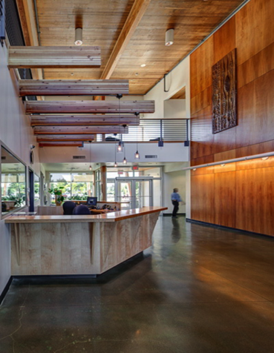
Co-location of Siuslaw National Forest Supervisor’s Office with the Corvallis Forestry Sciences Lab
Notes:
If you look closely in this photo you will see the beautiful art work on the walls, these are actually reclaimed doors from the old facility, we also utilized reclaimed tongue and groove ceiling and wall boards

Slide 14
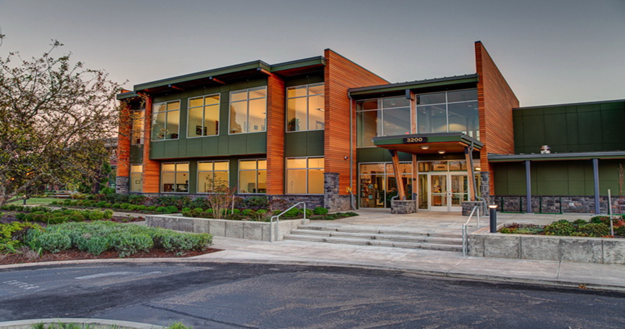
Co-location of Siuslaw National Forest Supervisor’s Office with the Corvallis Forestry Sciences Lab
Rolluda Architects, Seattle, Washington
& O’Neill Electric Inc., Portland, Oregon
Notes:
This is truly a spectacular state of the art, energy efficient, wood facility
$4,700,000 including both design and construction
Rolluda Architects in Seattle, Washington was the designer
O’Neill Electric Inc. was the prime construction contractor from Portland, Oregon

Slide 15
The Case for Building with Wood
Wood cost less both environmentally and economically
Wood is versatile, durable, resilient, renewable
Wood meets and often exceeds code
Wood plays a significant role in rural economies
Wood construction increases energy efficiencies - cuts carbon pollution
Healthy, resilient managed forests are less prone to fire, drought, insects and floods
Wood is a beautiful, architectural building product
Notes:
The Case for Building with Wood is clear:
And as you’ve seen today, “Wood is truly a beautiful, architectural building product
In summary, I hope after today’s workshop you have an increased awareness of the value of wood, the resources and tools available and the Forest Services commitment to you towards expanding our opportunities for partnership and collaboration.

Slide 16
“Our country has the resources, the work force, and the innovative spirit to reintroduce wood products into all aspects of the next generation of buildings.” Chief, US Forest Service, Tom Tidwell,
Emilee P. Blount PE
703-605-4962
eblount@fs.fed.us
Notes:
Finally, I’d like to leave you with a quote from the Chief of the US Forest Service; Tom Tidwell
PAUSE, 1, 2, 3, 4
Thank you

